Slide 1
Airport Simulator
(Design Specification) Team 8

Slide 2
Problem Statement
We are responsible for designing a new airport. One of the key decisions is to decide how many gates the new airport should have. This decision depends on how many flights the airport can handle safely without congestion. We have to simulate airport traffic (holding, take off, landing, scheduling, emergency lands). The parts of the traffic control simulation system that we write may be reused later for real traffic control system for the same airport.

Slide 3
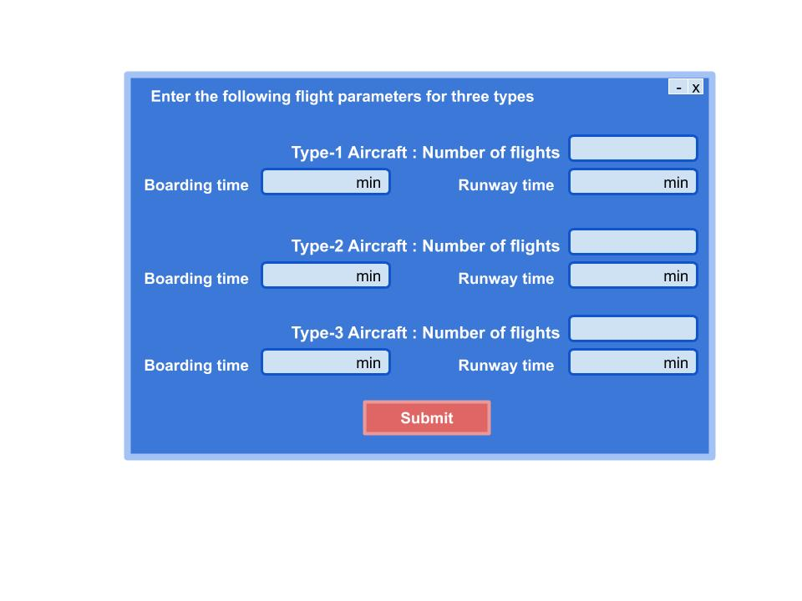
User Interface
Assumptions
We are considering only 3 types of aircraft. Taxi time is taken same for all aircrafts.

Slide 4
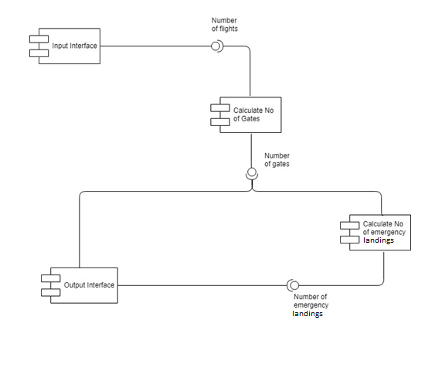
Component Diagram

Slide 5
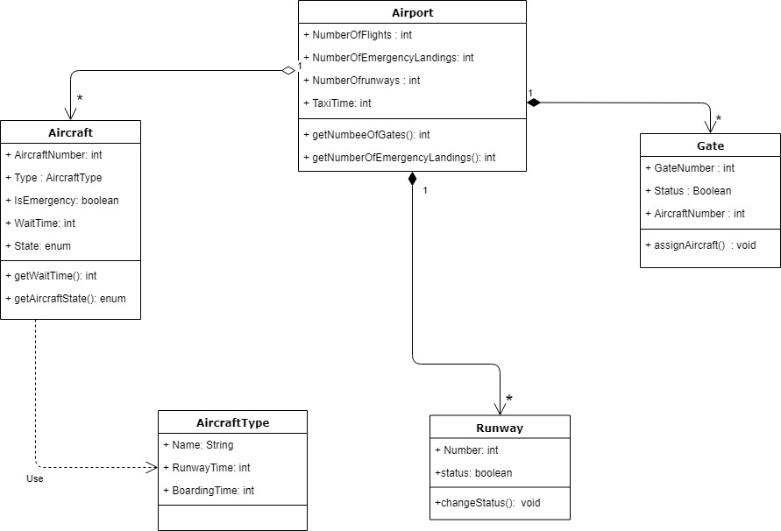
Class Diagram
1

Slide 6
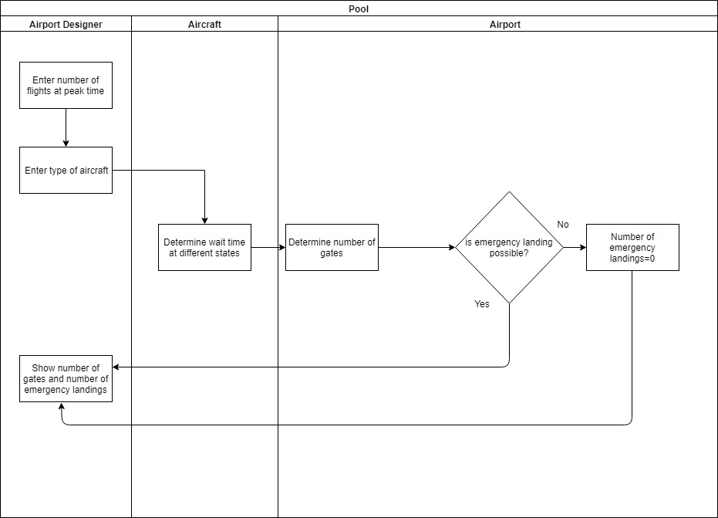
Swimlane Diagram

Slide 7
Error Handling
Error Condition | Alert Type | Message
No of flights <= 0 | Error | No. of flights should be positive
No of flights not an integer | Error | No. of flights should be an integer
Runway time <= 0 Boarding time <= 0 | Error | Time should be positive
Runway time and boarding time not an integer | Error | Time should be an integer

Slide 8
Technology Specification
Java
Swing GUI widget toolkit

Slide 9
Thank you

